Slide 1
Data Security: Lecture outline
What is data security? Why data security is important?
Benefits of data security and types of data security.
Phases of data security lifecycle
Data security regulations like GDPR, HIPPA, CCPA, PCI DSS and ISO 27001
What are data encryption and hashing? Types of encryption
Hashing properties
Differences between encryption and hashing
Database security considerations
1. Access control and authentication, 2. Data encryption, 3. Security, 4. Software and system security
Best practices for database security
Conclusion

Slide 2
What is data security?
Data security refers to the protective measures and protocols implemented to safeguard digital information from unauthorized access, corruption, theft, or damage throughout its lifecycle.
It is a critical aspect of information technology that spans various practices, technologies, and policies designed to protect data integrity, confidentiality, and availability.
Data security uses tools and technologies that enhance visibility of a company's data and how it is being used. These tools can protect data through processes like data masking, encryption etc. of sensitive information.

Slide 3
Why is Data Security Important?
1. Protecting Sensitive Information:
Data security safeguards sensitive information like customer data, financial records, intellectual property, and trade secrets from unauthorized access, misuse, or disclosure.
This protection is essential for maintaining the confidentiality and integrity of information, preventing potential harm to individuals and organizations.
2. Maintaining Customer Trust and Reputation:
A data breach can severely damage an organization's reputation and erode customer trust.
By prioritizing data security, organizations demonstrate their commitment to protecting customer data and fostering a sense of trust and confidence.
3. Ensuring Regulatory Compliance:
Many industries and jurisdictions have regulations that mandate specific data security standards and practices.
Organizations must comply with these regulations to avoid legal penalties and maintain operational integrity.

Slide 4
Why is Data Security Important?
4. Preventing Financial Losses:
Data breaches can result in significant financial losses, including the cost of remediation, legal fees, fines, and lost business.
Strong data security measures help prevent these losses by minimizing the risk of breaches and their associated consequences.
5. Supporting Business Continuity:
Data security is essential for ensuring the uninterrupted operation of businesses.
By protecting data from loss or corruption, organizations can maintain their ability to operate effectively and meet customer demands.
6. Enhancing Competitive Advantage:
Organizations that prioritize data security are better positioned to gain a competitive advantage in the market.
By demonstrating a commitment to data protection, organizations can attract and retain customers, build strong relationships, and enhance their brand image.

Slide 5
Benefits Of Data Security
Keeps your information safe:
By adopting a mindset focused on data security and implementing the right set of tools, you ensure sensitive data does not fall into the wrong hands. Sensitive data can include customer payment information, hospital records, and identification information, to name just a few.
2. Helps keep your reputation clean:
When people do business with your organization, they entrust their sensitive information to you, and a data security strategy enables you to provide the protection they need..
3. Gives you a competitive edge:
In many industries, data breaches are commonplace, so if you can keep data secure, you set yourself apart from the competition, which may be struggling to do the same.
5. Saves on support and development costs:
If you incorporate data security measures early in the development process, you may not have to spend valuable resources for designing and deploying patches or fixing coding problems down the road.

Slide 6
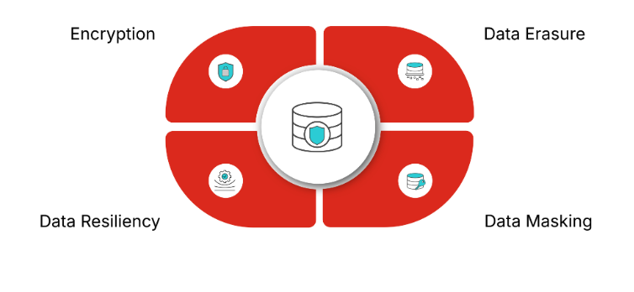
Types Of Data Security

Slide 7
Types Of Data Security: Data Encryption & data Eraser
Data encryption
It is the use of algorithms to scramble data and hide its true meaning. Encrypting data ensures messages can only be read by recipients with the appropriate decryption key.
This is crucial, especially in the event of a data breach, because even if an attacker manages to gain access to the data, they will not be able to read it without the decryption key.
2. Data erasure
There will be occasions in which organizations no longer require data and need it permanently removed from their systems. Data erasure is an effective data security management technique that removes liability and the chance of a data breach occurring.

Slide 8
Types Of Data Security: Data masking & Data resiliency
3. Data masking
Data masking enables an organization to hide data by obscuring and replacing specific letters or numbers. This process is a form of encryption that renders the data useless should a hacker intercept it.
The original message can only be uncovered by someone who has the code to decrypt or replace the masked characters.
4. Data resiliency
Organizations can mitigate the risk of accidental destruction or loss of data by creating backups or copies of their data. Data backups are vital to protecting information and ensuring it is always available.
This is particularly important during a data breach or ransomware attack, ensuring the organization can restore a previous backup.

Slide 9
Data encryption and data masking
Feature | Data Masking | Data Encryption
Purpose | Protect sensitive data while providing a functional alternative for testing and development | Protect sensitive data at rest and in transit
How it works | Replaces sensitive data with fake data | Transforms data into an unreadable format
Usability | Masked data is usable for testing and development | Encrypted data is not directly usable
Reversibility | Irreversible | Reversible with the correct key

Slide 10
Best Practices for Database Security
Classify Data: Identify and prioritize sensitive data for protection.
Implement Strong Authentication: Use MFA and strong password policies.
Encrypt Data: Protect data at rest, in transit, and in backups.
Monitor and Audit: Continuously monitor database activity and maintain audit logs.
Train Employees: Educate staff on database security best practices.
Regularly Update Software: Apply patches and updates to address vulnerabilities.
Test Security: Conduct regular penetration testing and vulnerability assessments.

Slide 11
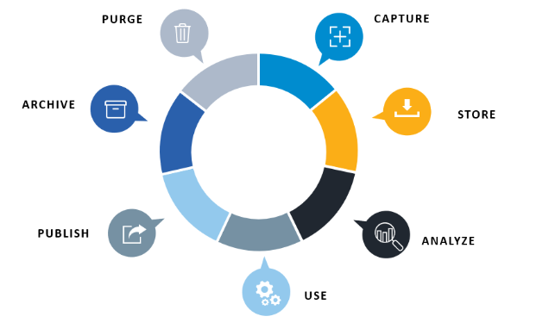
Phases in a Data Security Lifecycle
The data security lifecycle is made up of seven unique stages:
Capture
Store
Analyze
Use
Publish
Archive
Purge

Slide 12
Data Security Regulations

Slide 13
Data Security Regulations
Data security allows organizations to comply with industry and state regulations that include:
General Data Protection Regulations (GDPR)
California Consumer Privacy Act (CCPA)
Health Insurance Portability and Accountability Act (HIPAA)
Payment Card Industry Data Security Standard (PCI DSS)
International Standards Organization (ISO) 27001

Slide 14
General Data Protection Regulations (GDPR)
GDPR is a comprehensive data protection regulation enacted by the European Union (EU) to protect the privacy and personal data of EU citizens. It applies to any organization that processes the data of EU residents, regardless of where the organization is located.
Key Requirements:
Data minimization and purpose limitation.
Explicit consent for data collection and processing.
Right to access, rectify, and erase personal data.
Mandatory breach notification within 72 hours.
Benefits:
Strengthens data privacy rights for individuals.
Encourages transparency and accountability in data processing.
Imposes heavy fines for non-compliance (up to 4% of global annual turnover).

Slide 15
California Consumer Privacy Act (CCPA)
CCPA of 2018 gives consumers more control over the personal information that businesses collect about them and the CCPA regulations provide guidance on how to implement the law. This landmark law secures new privacy rights for California consumers, including:
The right to know about the personal information a business collects about them and how it is used and shared;
The right to delete personal information collected from them (with some exceptions);
The right to opt-out of the sale or sharing of their personal information including via the GPC;
The right to non-discrimination for exercising their CCPA rights.

Slide 16
Health Insurance Portability and Accountability Act (HIPAA)
HIPAA is a U.S. law that sets standards for protecting sensitive patient health information (PHI). It applies to healthcare providers, insurers, and their business associates.
Key Requirements:
Administrative, physical, and technical safeguards for PHI.
Regular risk assessments and employee training.
Breach notification to affected individuals and regulators.
Benefits:
Ensures the confidentiality and integrity of patient data.
Helps healthcare organizations avoid legal penalties and reputational damage.

Slide 17
Payment Card Industry Data Security Standard (PCI DSS)
PCI DSS is a set of security standards designed to protect payment card data and ensure secure transactions. It applies to organizations that handle credit card information.
Key Requirements:
Secure network and systems.
Encryption of cardholder data during transmission and storage.
Regular vulnerability testing and monitoring.
Implementation of access control measures.
Benefits:
Reduces the risk of payment card fraud and data breaches.
Builds customer confidence in payment security.
Avoids penalties and reputational damage from non-compliance.

Slide 18
International Standards Organization (ISO) 27001
ISO/IEC 27001 is one of the most widely recognized international standards for information security management systems (ISMS). It provides a framework for establishing, implementing, maintaining, and continually improving an organization's information security practices.
Key Features:
Risk assessment and management.
Implementation of security controls (aligned with ISO/IEC 27002).
Regular audits and continuous improvement.
Benefits:
Demonstrates a commitment to data security.
Enhances customer and stakeholder trust.

Slide 19
Importance of Data Security Standards
Risk Mitigation: Helps organizations identify and address vulnerabilities.
Regulatory Compliance: Ensures adherence to legal and industry-specific requirements.
Trust and Reputation: Builds confidence among customers, partners, and stakeholders.
Operational Efficiency: Streamlines security practices and reduces the likelihood of breaches.
Global Competitiveness: Demonstrates a commitment to data security, enhancing an organization's reputation in the global market.

Slide 20
Data encryption and hashing

Slide 21
Data encryption and hashing
What is Data Encryption?
Data encryption is the process of converting plaintext (readable data) into ciphertext (unreadable data) using an encryption algorithm and a key.
The goal is to ensure that only authorized parties with the correct decryption key can access the original data.
What is Hashing?
Hashing is a one-way process that converts input data (of any size) into a fixed-length string of characters, called a hash value or digest.
Unlike encryption, hashing is irreversible, meaning the original data cannot be retrieved from the hash.

Slide 22
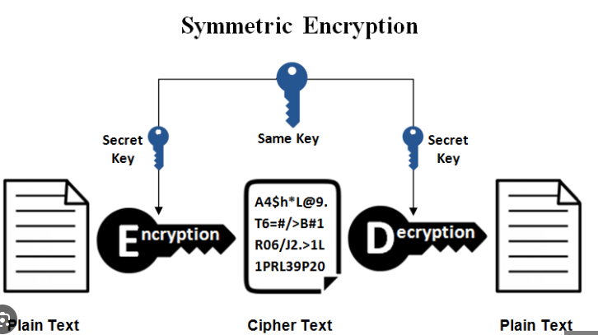
Types of Encryption: Symmetric Encryption
Uses the same key for both encryption and decryption.
Common Algorithms: AES (Advanced Encryption Standard), DES (Data Encryption Standard), 3DES, Blowfish.
Use Cases: File encryption, database encryption, secure communication.
Advantages: Fast and efficient for large volumes of data.
Challenges: Key distribution and management.

Slide 23
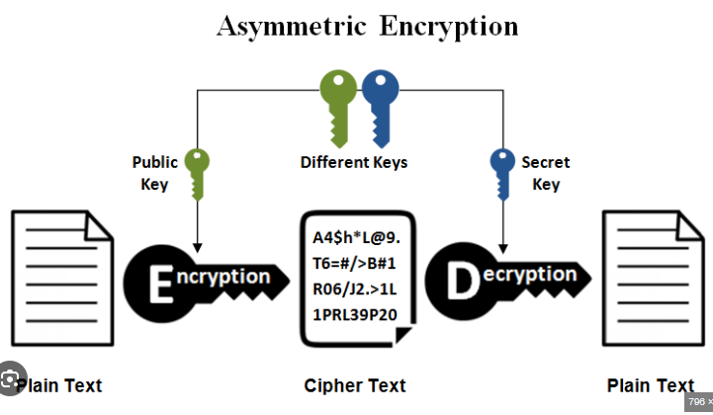
Types of Encryption: Asymmetric Encryption
Uses a pair of keys: a public key for encryption and a private key for decryption.
Common Algorithms: RSA (Rivest-Shamir-Adleman), ECC (Elliptic Curve Cryptography), Diffie-Hellman.
Use Cases: Secure email (PGP), SSL/TLS for web security, digital signatures.
Advantages: Solves the key distribution problem.
Challenges: Slower than symmetric encryption and requires more computational resources.

Slide 24
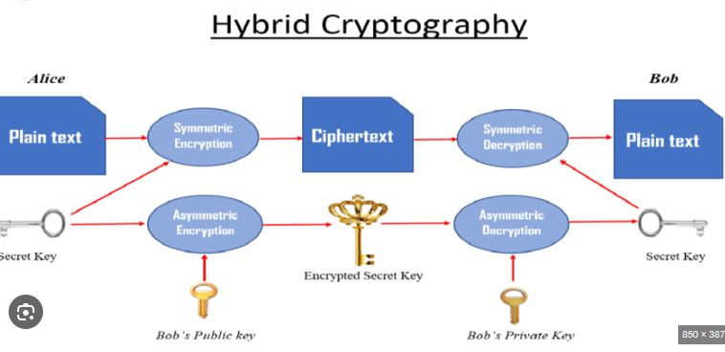
Types of Encryption: Hybrid Encryption
Combines symmetric and asymmetric encryption.
How It Works: Asymmetric encryption is used to securely exchange a symmetric key, which is then used for encrypting the actual data.
Use Cases: SSL/TLS, secure file transfer.

Slide 25
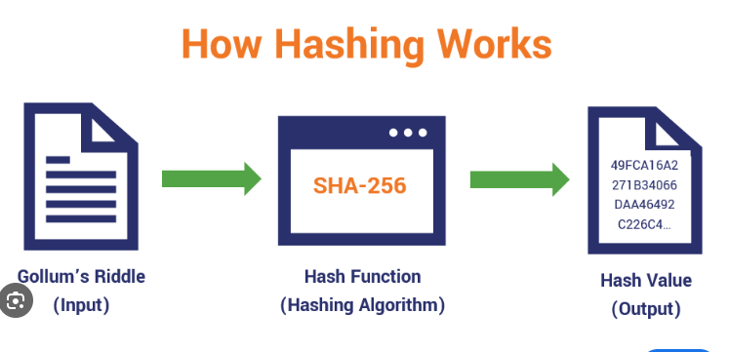
Properties of Hashing
Deterministic: The same input always produces the same hash.
Fixed-Length Output: Regardless of input size, the hash has a fixed length (e.g., 256 bits for SHA-256).
Pre-image Resistance: It should be computationally infeasible to reverse the hash to obtain the original input.
Avalanche Effect: A small change in input results in a significantly different hash.
Collision Resistance: It should be highly unlikely for two different inputs to produce the same hash.

Slide 26
Common Hashing Algorithms
1. MD5 (Message Digest Algorithm 5):
Produces a 128-bit hash.
Use Cases: Checksums for file integrity (not recommended for security due to vulnerabilities).
2. SHA (Secure Hash Algorithm):
SHA-1: Produces a 160-bit hash (deprecated due to vulnerabilities).
SHA-2: Includes SHA-224, SHA-256, SHA-384, and SHA-512 (widely used).
SHA-3: The latest version, based on a different design (Keccak).
3. bcrypt:
A password-hashing function designed to be slow and resistant to brute-force attacks.
Use Cases: Storing passwords securely.
4. Argon2:
A modern password-hashing algorithm that won the Password Hashing Competition in 2015.
Use Cases: Password storage, key derivation.

Slide 27
Hashing Use Cases
Password Storage: Storing hashed passwords instead of plaintext to protect user credentials.
Data Integrity: Verifying that data has not been tampered with (e.g., checksums for file downloads).
Digital Signatures: Creating a unique hash of a message to ensure authenticity and integrity.
Blockchain: Hashing is used to link blocks and ensure the immutability of the blockchain.

Slide 28
Differences Between Encryption and Hashing
Aspect | Encryption | Hashing
Purpose | Protect data confidentiality. | Ensure data integrity and authenticity.
Reversibility | Reversible (with the correct key). | Irreversible.
Output | Ciphertext (variable length). | Hash value (fixed length).
Key Usage | Requires a key (symmetric or asymmetric). | No key required.
Use Cases | Secure communication, data storage. | Password storage, data integrity checks.

Slide 29
Challenges and Considerations of encryption and hashing
Encryption Challenges
Performance Overhead: Encryption can slow down systems, especially for large datasets.
Key Management: Securely storing and distributing keys is complex.
Quantum Computing Threat: Future quantum computers could break current encryption algorithms, leading to the development of post-quantum cryptography.
Hashing Challenges
Collision Attacks: Weak hashing algorithms can produce the same hash for different inputs.
Brute-Force Attacks: Weak passwords can be cracked using brute-force methods.
Algorithm Deprecation: Older algorithms become vulnerable over time and must be replaced.

Slide 30
Database security considerations

Slide 31
Database security considerations
Database security is a critical aspect of protecting sensitive data stored in databases from unauthorized access, breaches, and other threats.
Databases contain valuable information, such as personal data, financial records, and intellectual property, making them a prime target for cyberattacks.
To ensure database security, implement strong authentication, access controls, encryption, regular backups, and continuous monitoring, while also addressing physical security and staying updated with security patches.

Slide 32
Database security consideration
1. Access Control & Authentication
a) Strong Authentication:
Implement robust authentication mechanisms, including multi-factor authentication (MFA), to verify user identities.
b)Principle of Least Privilege:
Grant users only the necessary permissions to perform their tasks, minimizing potential damage from compromised accounts.
c) Role-Based Access Control (RBAC):
Assign users roles with specific permissions, rather than individual permissions, simplifying management and reducing the risk of errors.
d) Secure Database User Accounts:
Ensure database user accounts are strong and not easily guessed, and consider using service accounts for applications.

Slide 33
Database security…
2. Data Encryption
a)Encryption at Rest:
Encrypt sensitive data stored in the database to protect it even if the database is compromised.
b)Encryption in Transit:
Secure data transmission between the database and applications using encryption protocols like SSL/TLS.
c) Data Masking:
Mask sensitive data to protect it from unauthorized access, even if someone gains access to the database.

Slide 34
Database security…
3. Security
a) Firewalls:
Implement firewalls to protect the database server from unauthorized access and malicious traffic.
b) Database Firewalls:
Use database firewalls to monitor and control database traffic, blocking malicious queries and unauthorized access attempts.
c) Intrusion Detection Systems (IDS):
Deploy IDS to monitor database activity and detect suspicious or malicious behavior.
d) Regular Backups:
Regularly back up the database to ensure data recovery in case of a breach or failure.
e) Secure Backups:
Store backups in a secure, offsite location to protect them from physical threats and unauthorized access.
f) Database Activity Monitoring (DAM):
Continuously monitor database activity to detect and respond to potential security threats.
g) Physical Security:
Secure the physical location of the database server, including access control and surveillance.
h) Regular Security Assessments:
Conduct regular security assessments and penetration testing to identify vulnerabilities and weaknesses.

Slide 35
Database security…
4. Software and System Security
a) Keep Software Updated:
Regularly update the database management system (DBMS) and associated software to patch security vulnerabilities.
b) Separate Test and Production Environments:
Isolate test and production databases to prevent security issues in the production environment from affecting development.
c) Secure the Underlying System:
Ensure the operating system and network infrastructure are secure and protected from attacks.
d) Data Classification:
Classify data based on sensitivity and implement appropriate security controls.
e) Data Integrity:
Implement measures to ensure data integrity and prevent unauthorized modifications.
f) Data Auditing:
Implement database auditing to track and monitor user activity and identify potential security issues.
g) Data Backup and Recovery:
Implement robust data backup and recovery procedures to ensure business continuity in case of a disaster.

Slide 36
Best Practices for Database Security
Classify Data: Identify and prioritize sensitive data for protection.
Implement Strong Authentication: Use MFA and strong password policies.
Encrypt Data: Protect data at rest, in transit, and in backups.
Monitor and Audit: Continuously monitor database activity and maintain audit logs.
Train Employees: Educate staff on database security best practices.
Regularly Update Software: Apply patches and updates to address vulnerabilities.
Test Security: Conduct regular penetration testing and vulnerability assessments.

Slide 37
Conclusion
Database security is a multifaceted discipline that requires a combination of technical, administrative, and physical measures.
By implementing robust access controls, encryption, monitoring, and compliance practices, organizations can protect their databases from unauthorized access, breaches, and other threats.
Regular audits, employee training, and staying updated on emerging threats are essential to maintaining a strong database security.
posture.
As databases continue to grow in size and complexity, proactive and comprehensive security measures are critical to safeguarding sensitive information.

